Slide 1
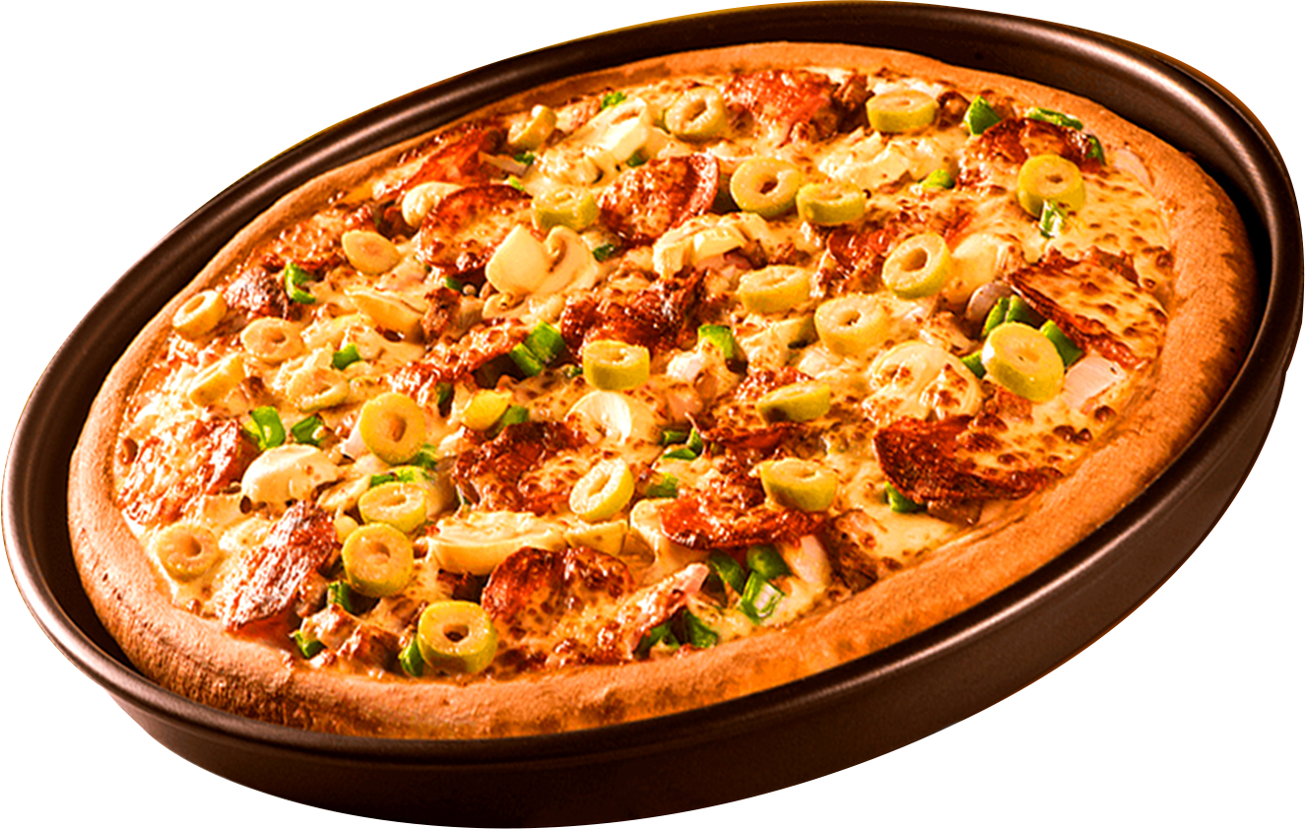


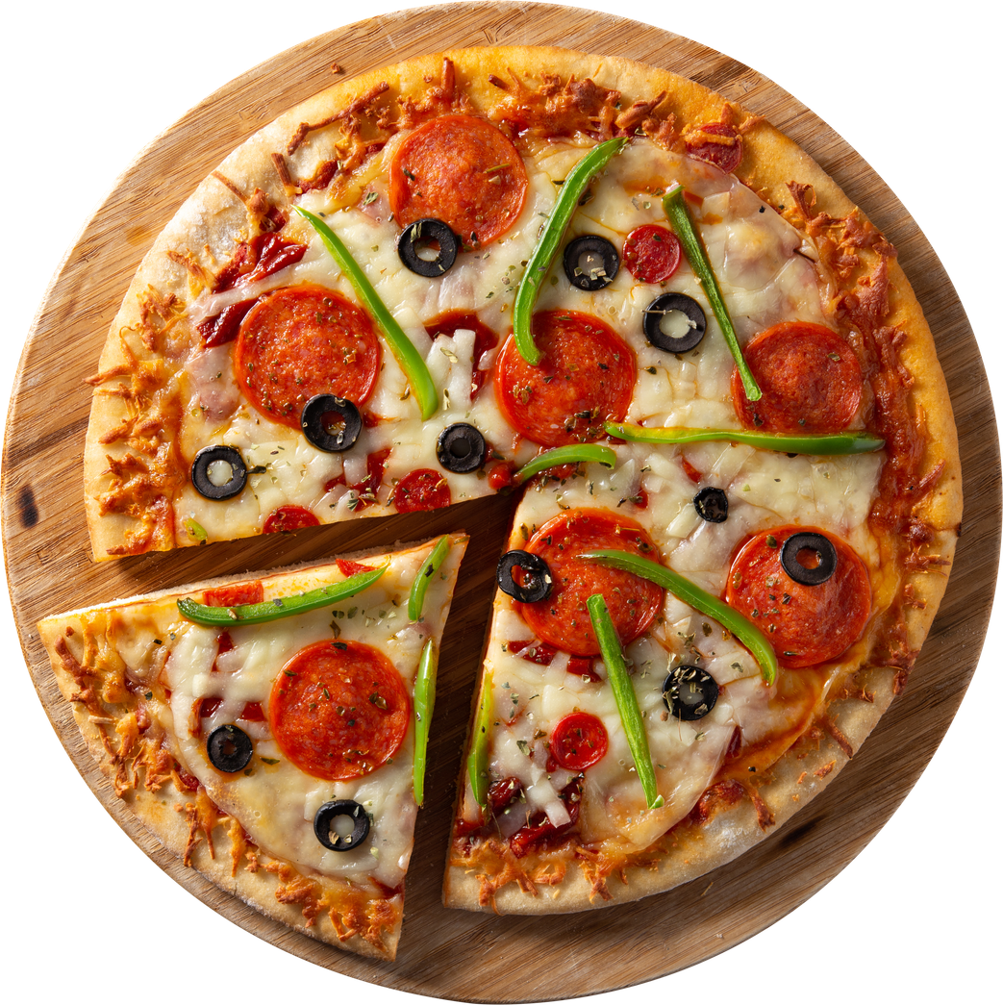
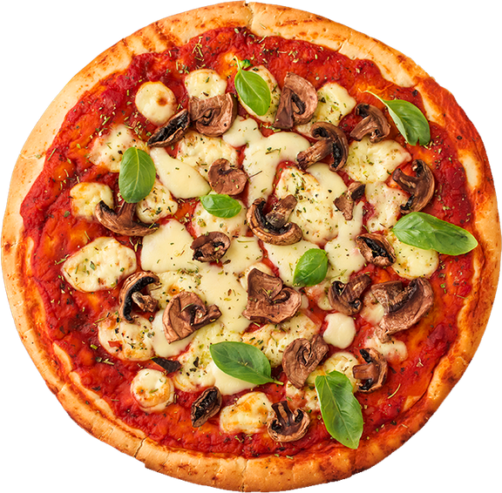


PIZZA COMPANY PERFORMANCE ANALYSIS
Leveraging SQL Analytics to Drive Business Growth
Where Every Slice Tells a Story
PREPARED BY: SUKHADA KULKARNI

Slide 2
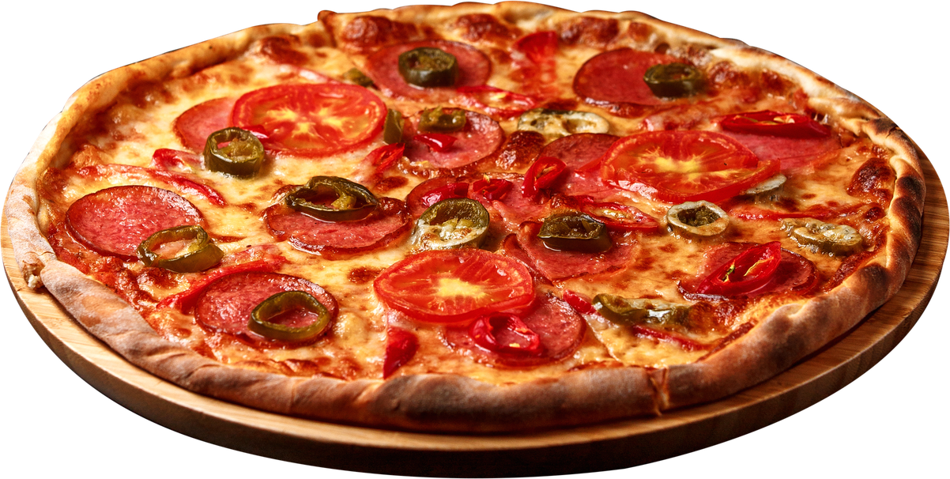
WHAT'S
INSIDE
Executive KPI Dashboard
Revenue Leaders & Laggards
Revenue Performance Drivers
Our Story
Presentation
Ingredient Demand Analysis
Customer Ordering Pattern by Hour
Customer Purchase Pattern
Sales Trends and Business Risk
Strategic Reccomendations
Expected Business Impact
06
02
Executive Summary

Slide 3
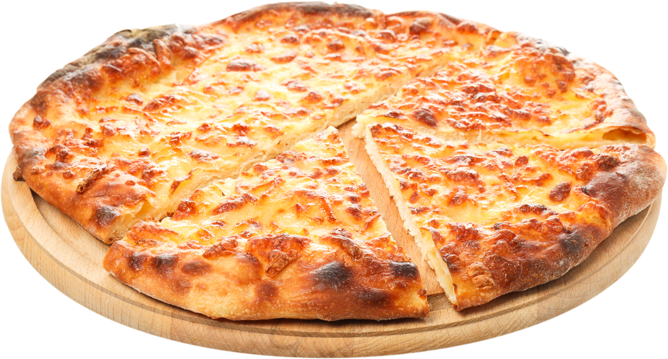
Executive KPI Dashboard
Total Revenue
Total Orders
Pizzas Sold
$817.9K
21.35K
49.6K
Average Order Size
Peak Hours
Best-Selling Size
2
12 PM
Large
Key Insight: Large-sized pizzas generated the highest revenue ($817.9K) across 21.35K orders, making them the strongest revenue driver.

Slide 4

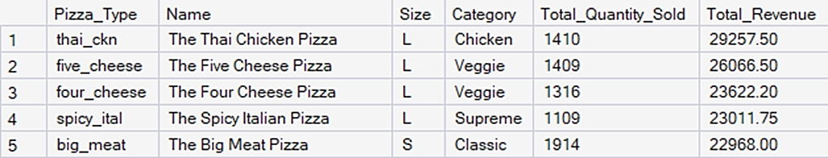

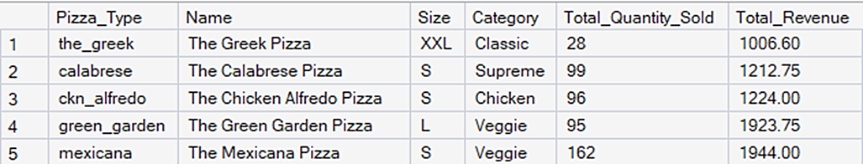
Revenue Leaders & Laggards
Top 5 Revenue Contributors
Bottom 5 Revenue Contributors
Recommendation : Focus promotions on Large pizzas while testing bundle offers for XL and XXL sizes.

Slide 5
Revenue Performance Drivers
Key Insight : Large pizzas generated nearly 45.9% of total revenue, making size the strongest revenue driver.

Slide 6
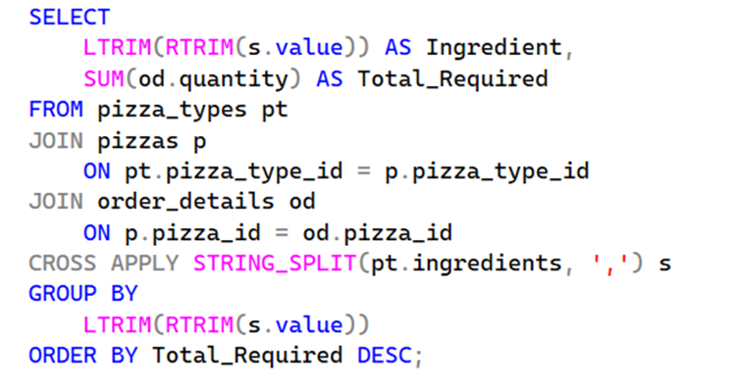
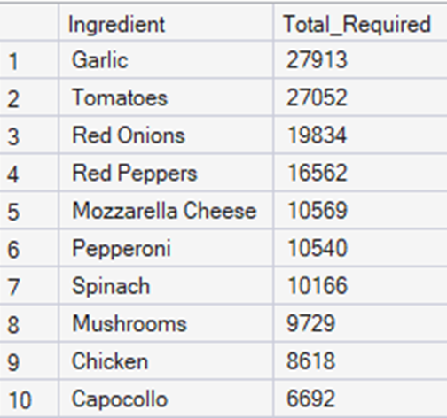
Ingredient Demand Analysis
SQL Query:
Top 10 Ingredients:
Business Insight: Frequently used ingredients should receive procurement priority to minimize stock shortages and improve inventory efficiency.

Slide 7
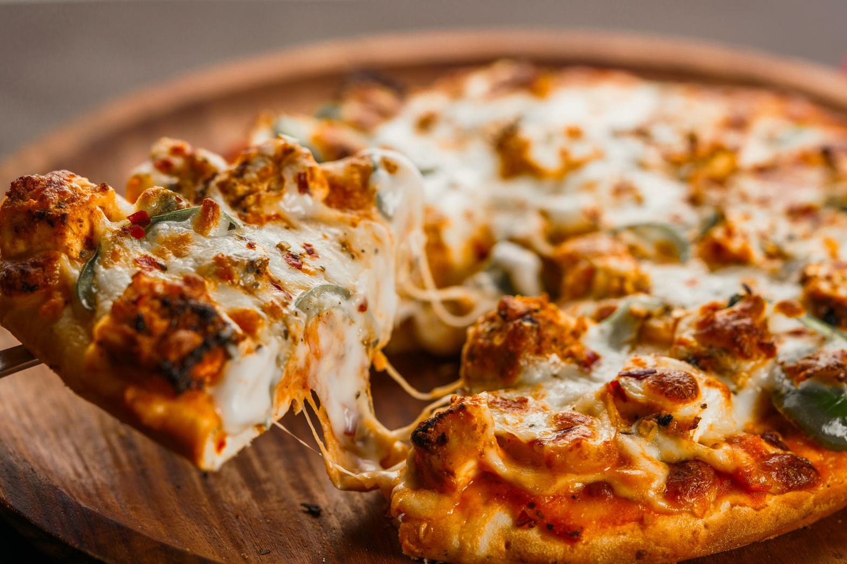
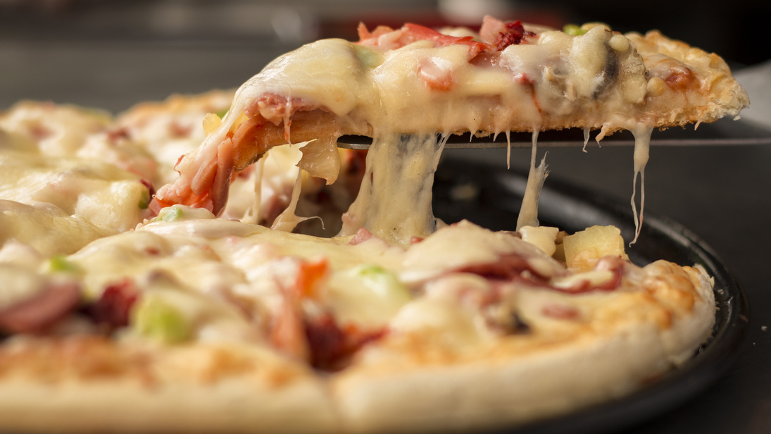
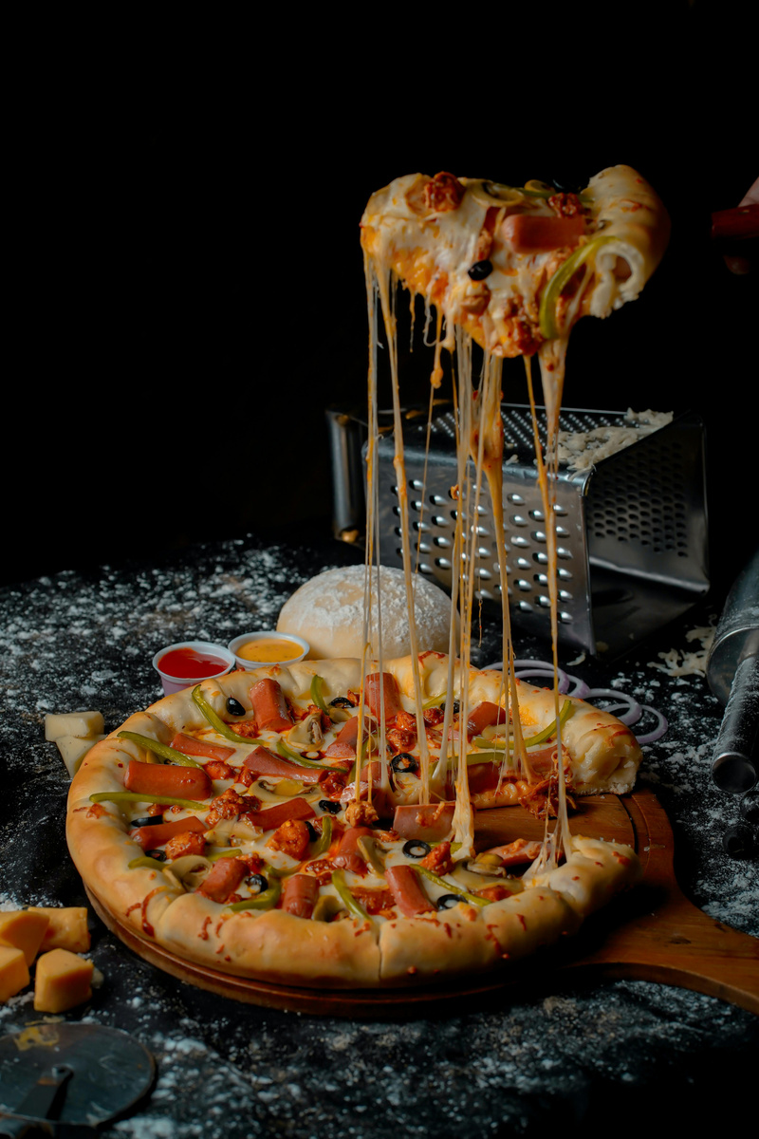
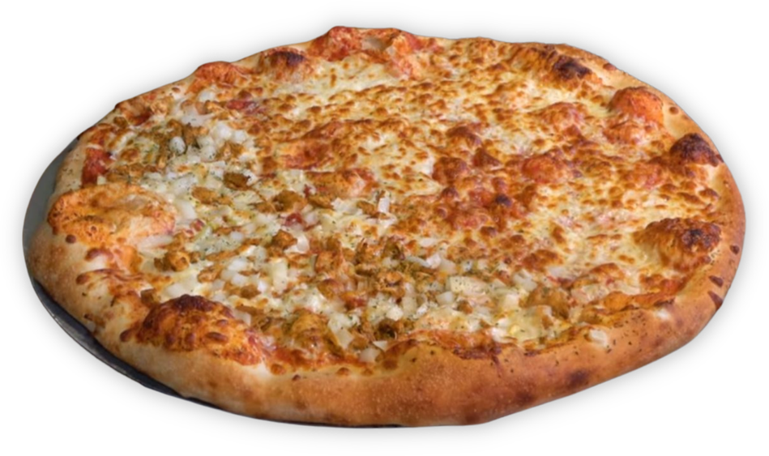
Customer Ordering Pattern by Hour
200
SUCCESS
STORY
Pizzas Delivered
Order demand follows a clear daily pattern, with peak activity occurring during lunch (12 PM–1 PM) and dinner (5 PM–7 PM) hours.
Early morning and late-night periods record the lowest order volumes.
Wardiere Inc. Corporate Catering
500
When Wardiere Inc. needed a reliable catering partner for their 500-person annual gala, La Pizzeria delivered 200 freshly made pizzas on time, with zero complaints.
Our team handled full setup, custom menu curation, and live pizza stations — turning a corporate event into an unforgettable culinary experience.
Guests Served
100%
Satisfaction Rate
Business Insight: Schedule additional staff and prepare inventory during lunch and dinner peak hours to reduce wait times and improve service efficiency.

Slide 8
Customer Purchase Patterns
Business Insight : Optimize staffing during peak hours and leverage midweek demand to maximize sales.

Slide 9



Sales Trends & Business Risks
Revenue Trend
Business Risk
Recommendation
•Revenue remained stable ($63K - $74K)
•July achieved the highest monthly revenue
•Limited Month-over-Month revenue growth
•Revenue is concentrated in a few top-selling products
•Optimize low performing menu items
•Increase focus on high-margin & high-demand products
Executive Insight : Stable revenue reflects consistent customer demand, while optimizing underperforming menu items can further improve profitability.

Slide 10
Strategic Recommendations
Sales Growth
Marketing
•Promote top-selling Classic pizzas
•Create combo meals with beverages/sides
•Increase sales of Large-size pizzas
•Upsell high-margin side items
•Launch weekday promotional offers
•Increase weekend marketing campaigns
•Introduce lunch-time combo deals
•Reward repeat customers with loyalty offers
Product Strategy
Operations
•Expand popular Classic pizza options
•Improve or replace low-performing pizzas
•Introduce seasonal and limited-time flavors
•Focus inventory on high-demand categories
•Stock more ingredients for top-selling pizzas
•Schedule more staff during peak hours
•Reduce waste from slow-moving products
•Improve demand forecasting using sales trends

Slide 11
Expected Business Impact
Revenue Growth
Inventory Optimization
Operational Efficiency
Action
Promote Best Sellers
Expected Outcome
Higher sales from high-performing products
Action
Prioritize Core Ingredients
Expected Outcome
Lower inventory waste
Action
Align Peak-Hour Staffing
Expected Outcome
Faster order fulfillment
Marketing Performance
Product Strategy
Decision Support
Action
Target Weekday Campaigns
Expected Outcome
Increased customer engagement
Action
Review Low Performers
Expected Outcome
Optimized menu portfolio
Action
KPI Monitoring
Expected Outcome
Faster strategic decisions

Slide 12
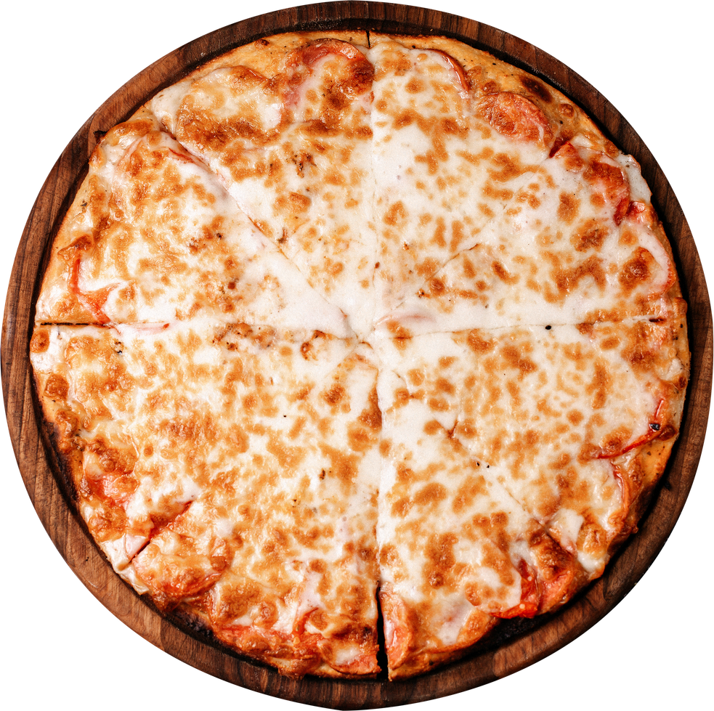
EXECUTIVE SUMMARY
Findings | Business Impact
Large pizzas drive revenue | Focus on premium sizes
Weekdays generate 73% of orders | Optimize weekday staffing
July recorded highest sales | Increase mid-year inventory
Top 5 pizzas dominate revenue | Promote best sellers
Bottom 5 pizzas contribute <1% each | Review menu performance

Slide 13
This analysis demonstrates how data-driven decision-making can improve sales performance, optimize operations, and enhance customer satisfaction.
Thank You!

